Slide 1


Unit 1: Lesson 4
School is…

Slide 2
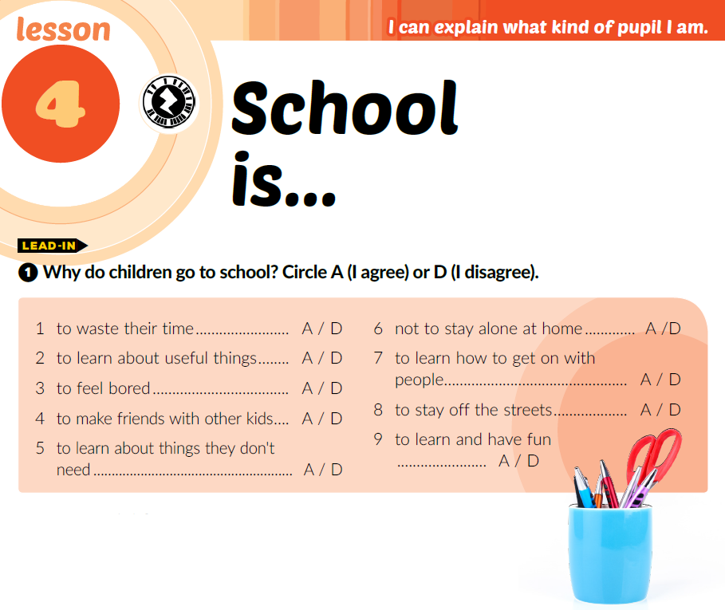
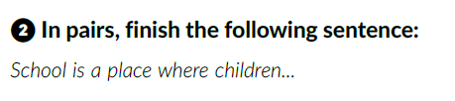

Slide 3

Možete li, molim vas, ponoviti?
Kako se to kaže na engleskom?
Koja stranica?
Mogu li ja reći?
Koja je hrvatska riječ za to?
Kako se to piše?
Mogu li izići van, molim vas?
Ne razumijem. Možete li objasniti, molim vas?

Slide 4
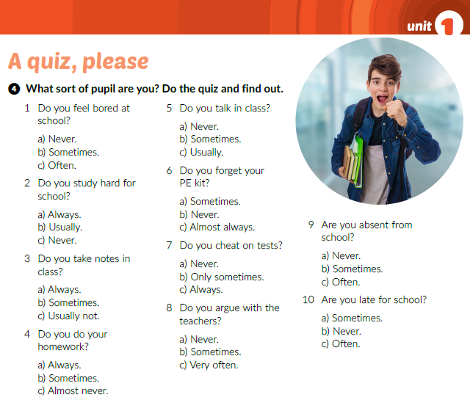
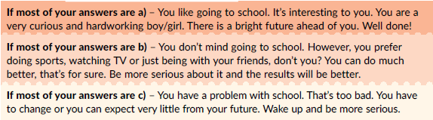

Slide 5



Slide 6
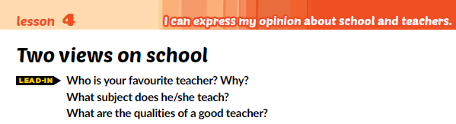

My favourite teacher is…. because he/she is/can/has….
He/she teaches…
A good teacher is….
A good teacher must have…
A good teacher should….
A good teacher can…

Slide 7
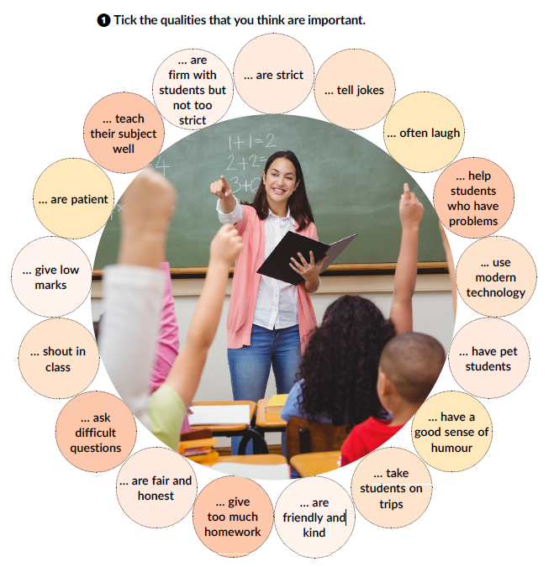

Slide 8
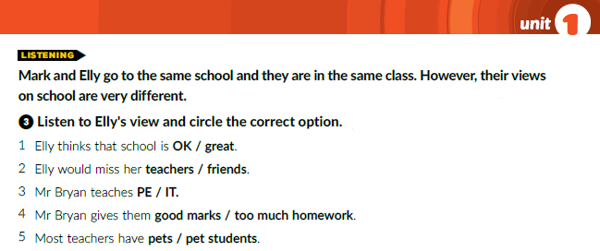
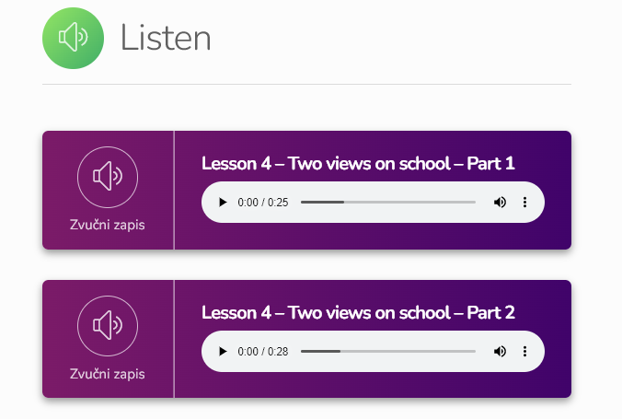

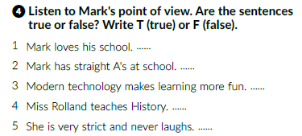
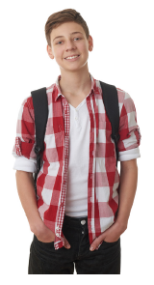
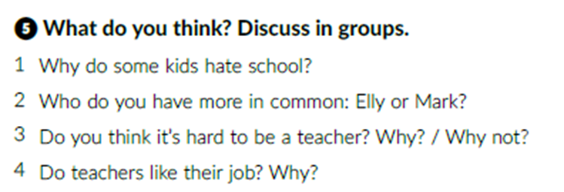
https://www.e-sfera.hr/dodatni-digitalni-sadrzaji/1e0f5584-f0ca-498c-8645-caf1a1b78448/
T
F
T
F
F

Slide 9


Slide 10
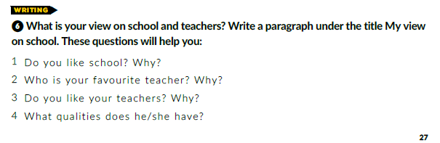

Slide 11
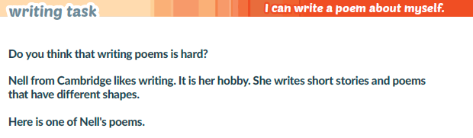
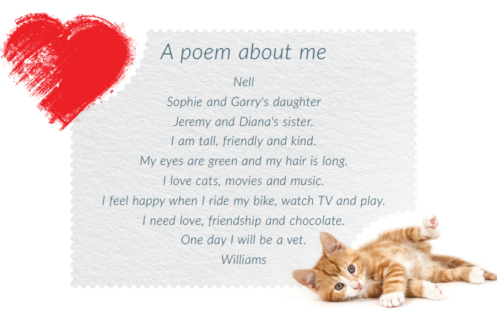

Slide 12
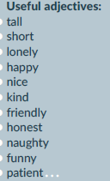
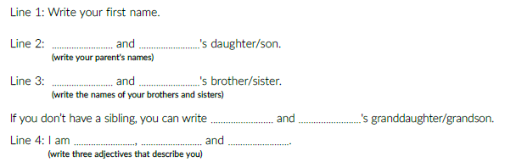
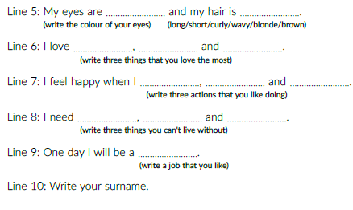
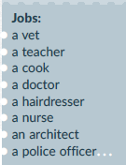
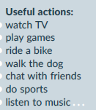

Slide 13
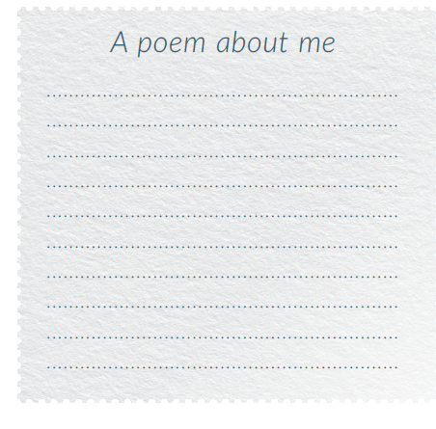

Slide 15
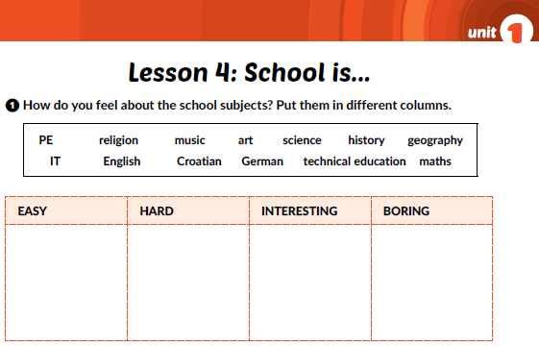
Workbook p. 17

Slide 16
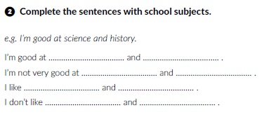

Slide 17
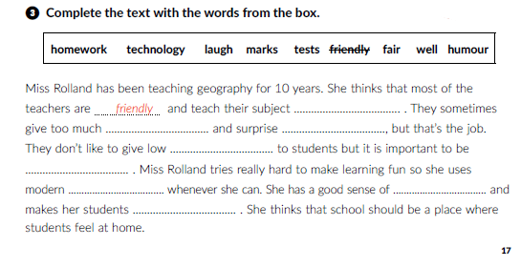
well
homework
tests
marks
fair
technology
humour
laugh

Slide 18
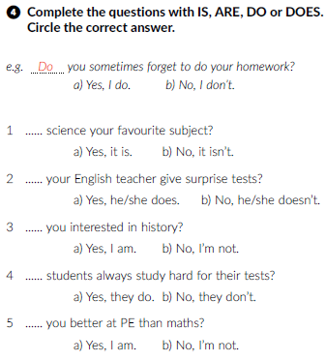
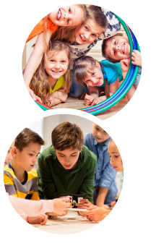
Is
Does
Are
Do
Are

Slide 19
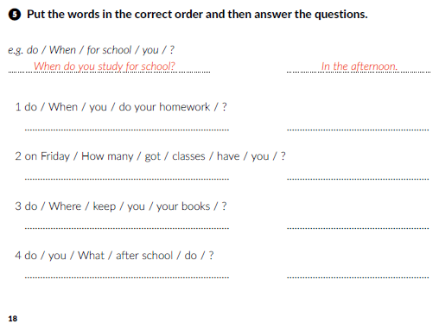
When do you do your homework
After school. / In the morning. / In the evening.
How many classes have you got on Friday?
Four / Five / Six classes.
Where do you keep your books?
On the shelf. / On my desk. / In the bag.
What do you do after school?
I do my homework. I play with my friends. / I go to tennis practice.

Slide 20
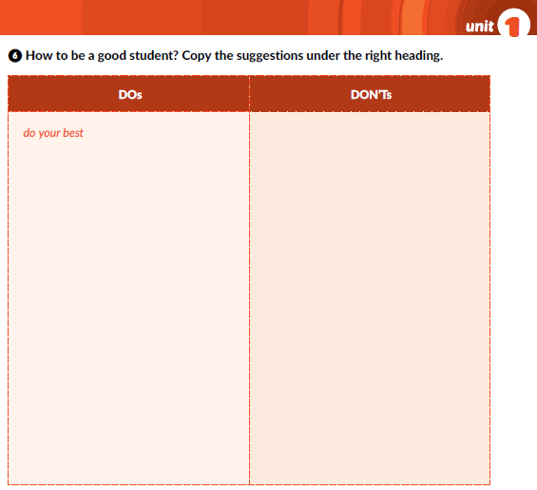
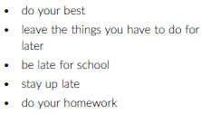
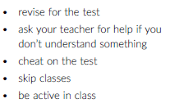
leave the things you have to do
for later
do your homework
be late for school
revise for the test
stay up late
ask your teacher for help if
you don’t understand something
cheat on the test
be active in class
skip classes

Slide 21
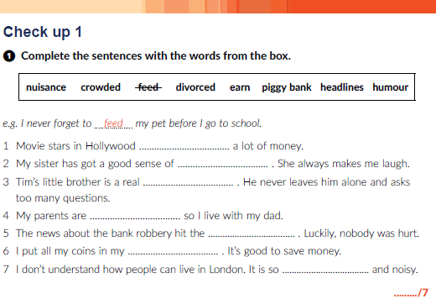
earn
humour
nuisance
divorced
headlines
piggy bank
crowded

Slide 22
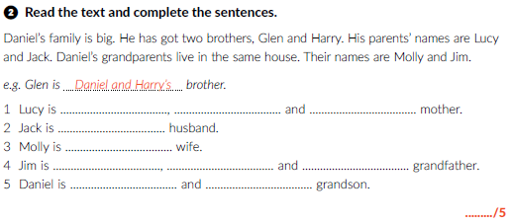
Daniel
Glen
Harry’s
Lucy’s
Jim’s
Daniel
Glen
Harry’s
Molly
Jim’s

Slide 23
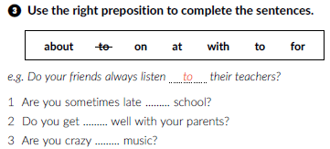



for
on
about
to
at
with

Slide 24
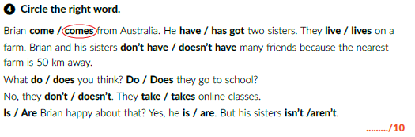

Slide 25
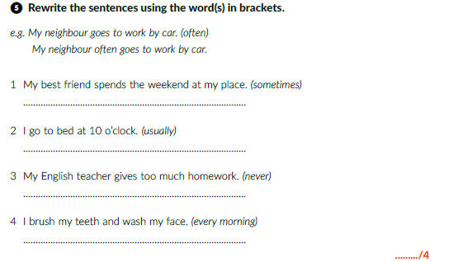

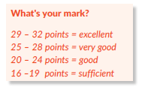

My best friend sometimes spends the weekend at my place.
I usually go to bed at 10 o’clock.
My English teacher never gives too much homework.
I brush my teeth and wash my face every morning.

Slide 26
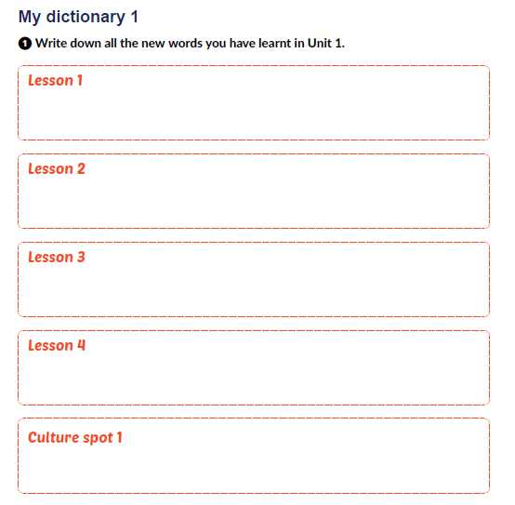
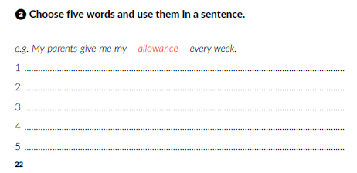
area, borrow, nuisance, canteen
allowance, besides, chore, compare, deliver,
divorced, hardworking
blockbuster, have in common, hit headlines, own
good-looking, impatient, lazy, responsible stuty hard, take are of, waste
anthem, capital, quirky, tourist destination

Slide 27
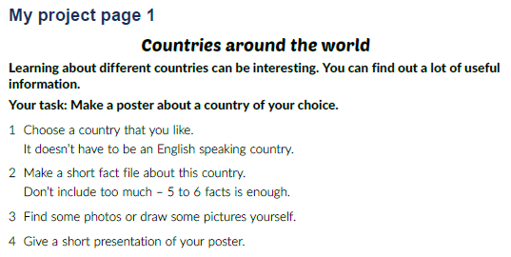
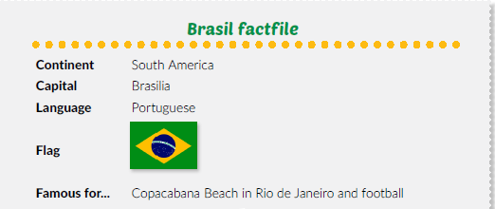

Slide 28

PLAY AND LEARN
https://www.e-sfera.hr/dodatni-digitalni-sadrzaji/1e0f5584-f0ca-498c-8645-caf1a1b78448/

